Slide 1
Merge sort
Mack 2023
Notes:
Last updated: 12-9-2022

Slide 2

Birthday time
Starter activity
Some people in your form have written their birthdays on a card that you want to put on display. Both groups of cards have been given to you ordered by academic year, from September to August.
Describe how you would put both groups of cards together so they are all in one group that is ordered by academic year.
Think, write, pair, share.
Daisy 18th Sept | Mo 5th Dec | Alicia 9th May |  | Nina 2nd Nov | Malik 28th May | Andre 4th Aug

Slide 3

Lesson 52: Merge sort
Objectives
In this lesson, you will:
Merge two ordered lists of items into a new ordered list
Describe how merge sort is used for ordering a list of items
Perform a merge sort to order a list containing sample data

Slide 4
Combining two groups of items
Activity 1
In the previous activity, do you think the steps you described would have been the same if the two groups of birthdays weren’t already in order?
Do you think it would be faster to put two groups of items together into one ordered collection if the original groups are sorted or unsorted?

Slide 5
Combining two groups of items
Activity 1
It is often much quicker to combine two groups of items that are already in order together into a new group to help maintain that order.
In computer science, an algorithm called merge sort can be used to combine pairs of sorted lists repeatedly until all the items are in order.

Slide 6
Combining two groups of items
Activity 1
You can see how two groups of sorted items can be merged together by using the birthdays from the previous activity as an example.
List 1:
List 2:
Daisy 18th Sept | Mo 5th Dec | Alicia 9th May |  | Nina 2nd Nov | Malik 28th May | Andre 4th Aug

Slide 7
Combining two groups of items
Activity 1
To work out which item should go first in the new merged group, compare the items at the start of both lists.
List 1:
List 2:
Daisy 18th Sept | Mo 5th Dec | Alicia 9th May |  | Nina 2nd Nov | Malik 28th May | Andre 4th Aug

Slide 8
Combining two groups of items
Activity 1
Place the item that comes first into a new merged list. Daisy’s birthday comes before Nina’s in the school year, so add Daisy’s birthday to the merged list.
List 1:
List 2:
Daisy 18th Sept | Mo 5th Dec | Alicia 9th May |  | Nina 2nd Nov | Malik 28th May | Andre 4th Aug
Merged list:
Daisy 18th Sept

Slide 9
Combining two groups of items
Activity 1
Now compare the items at the start of each list for the remaining items, which in this case is Mo’s birthday and Nina’s birthday.
List 1:
List 2:
 | Mo 5th Dec | Alicia 9th May |  | Nina 2nd Nov | Malik 28th May | Andre 4th Aug
Merged list:
Daisy 18th Sept

Slide 10
Combining two groups of items
Activity 1
Nina’s birthday comes before Mo’s in the school year, so place Nina’s birthday into the next position in the merged list.
List 1:
List 2:
 | Mo 5th Dec | Alicia 9th May |  | Nina 2nd Nov | Malik 28th May | Andre 4th Aug
Merged list:
Daisy 18th Sept | Nina 2nd Nov

Slide 11
Combining two groups of items
Activity 1
For the remaining items, compare the items at the start of list 1 and list 2 and place the item that comes first into the merged list.
List 1:
List 2:
 | Mo 5th Dec | Alicia 9th May |  |  | Malik 28th May | Andre 4th Aug
Merged list:
Daisy 18th Sept | Nina 2nd Nov

Slide 12
Combining two groups of items
Activity 1
Mo’s birthday comes before Malik’s, so add Mo’s birthday to the merged list of items.
List 1:
List 2:
 | Mo 5th Dec | Alicia 9th May |  |  | Malik 28th May | Andre 4th Aug
Merged list:
Daisy 18th Sept | Nina 2nd Nov | Mo 5th Dec

Slide 13
Combining two groups of items
Activity 1
Which item will be added to the merged list next?
List 1:
List 2:
 |  | Alicia 9th May |  |  | Malik 28th May | Andre 4th Aug
Merged list:
Daisy 18th Sept | Nina 2nd Nov | Mo 5th Dec

Slide 14
Combining two groups of items
Activity 1
Alicia’s birthday comes before Malik’s, so add Alicia’s birthday to the merged list of items.
List 1:
List 2:
 |  | Alicia 9th May |  |  | Malik 28th May | Andre 4th Aug
Merged list:
Daisy 18th Sept | Nina 2nd Nov | Mo 5th Dec | Alicia 9th May

Slide 15
Combining two groups of items
Activity 1
When no items remain in one of the lists, copy the items that remain in the other list into the merged list.
List 1:
List 2:
 |  |  |  |  | Malik 28th May | Andre 4th Aug
Merged list:
Daisy 18th Sept | Nina 2nd Nov | Mo 5th Dec | Alicia 9th May | Malik 28th May

Slide 16
Combining two groups of items
Activity 1
When no items remain in one of the lists, copy the items that remain in the other list into the merged list.
List 1:
List 2:
 |  |  |  |  |  | Andre 4th Aug
Merged list:
Daisy 18th Sept | Nina 2nd Nov | Mo 5th Dec | Alicia 9th May | Malik 28th May | Andre 4th Aug

Slide 17
Combining two groups of items
Activity 1
You have successfully completed one merge of a merge sort by combining a pair of ordered lists into a new sorted list.
List 1:
List 2:
Merged list:
Daisy 18th Sept | Nina 2nd Nov | Mo 5th Dec | Alicia 9th May | Malik 28th May | Andre 4th Aug

Slide 18
Algorithm for one merge of a merge sort
Activity 1
The instructions for performing one merge of a merge sort can be written as:
Take two lists of data to be merged.
Create a new empty list for the merged items.
Repeat steps a-b until one of the lists of items is empty:
Compare the first items of the two lists.
Remove the item that is lower and place it into the merged list, in the next available position.
Then place each item from the remaining list into the merged list in order.
Merge

Slide 19

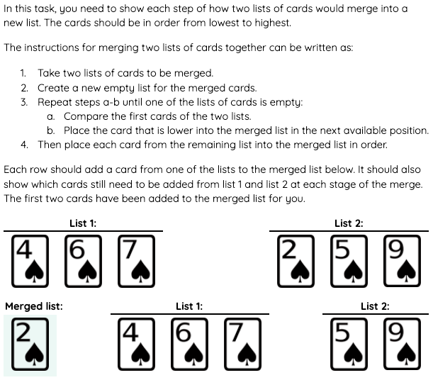
Merging two lists of cards
Activity 1
You are now going to execute one merge a merge sort on two lists of cards.
Fill in the table on the Activity 1 worksheet to show the merged list at each stage of the algorithm.

Slide 20
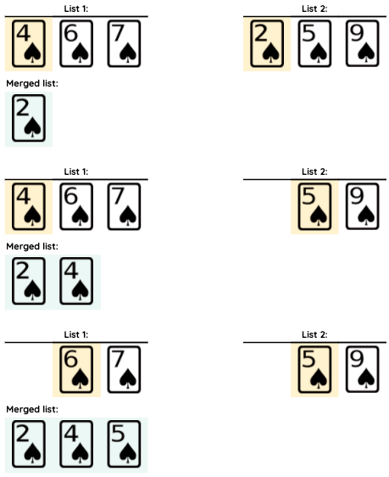
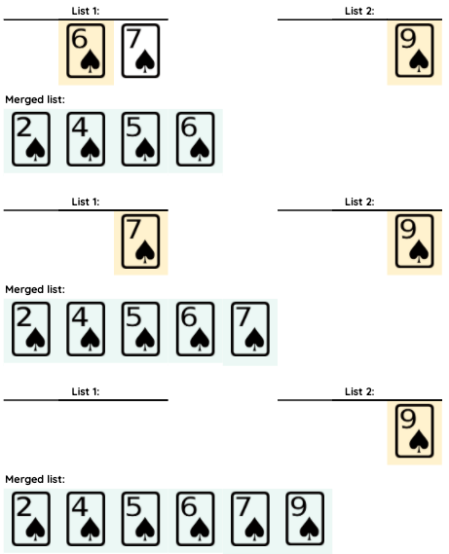

Activity 1

Slide 21

Merge sort
Activity 2
The merge sort algorithm has two parts: splitting items and merging items.
Splitting:
The first part of a merge sort it to continuously split a list in half until all the elements are in a list by themselves.
Merging:
These individual lists are then merged, one pair at a time, into new ordered lists. This is repeated until all the lists have been merged into one ordered list.

Slide 22
Merge sort: splitting phase
Activity 2
43 | 21 | 14 | 50 | 64 | 3 | 19
Take a list of data to be sorted.

Slide 23
Merge sort: splitting phase
Activity 2
43 | 21 | 14 | 50 | 64 | 3 | 19
43 | 21 | 14 | 50
64 | 3 | 19
Split the list in the middle into two lists. If there are an odd number of items, the first list will include the middle item.

Slide 24
Merge sort: splitting phase
Activity 2
43 | 21 | 14 | 50 | 64 | 3 | 19
43 | 21 | 14 | 50
64 | 3 | 19
43 | 21
14 | 50
64 | 3
19
Continue splitting the lists in the middle until each item is in a list of its own.

Slide 25
Merge sort: splitting phase
Activity 2
43 | 21 | 14 | 50 | 64 | 3 | 19
43 | 21 | 14 | 50
64 | 3 | 19
43 | 21
14 | 50
64 | 3
19
43
21
14
50
64
3
19

Slide 26
Merge sort: merging phase
Activity 2
43
21
14
50
64
3
19
Now that each item is in a list of its own, start merging pairs of lists together so that the items are in order.

Slide 27
Merge sort: merging phase
Activity 2
43
21
14
50
64
3
19
Take two lists of data to be merged and create a new empty list.

Slide 28
Merge sort: merging phase
Activity 2
43
21
14
50
64
3
19
21 | 43
Merge the two lists together so that the items are in order.

Slide 29
Merge sort: merging phase
Activity 2
43
21
14
50
64
3
19
21 | 43
Take the next pair of lists to be merged and create a new empty list.

Slide 30
Merge sort: merging phase
Activity 2
43
21
14
50
64
3
19
21 | 43
14 | 50
Merge the two lists together so that the items are in order.

Slide 31
Merge sort: merging phase
Activity 2
43
21
14
50
64
3
19
21 | 43
14 | 50
Take the next pair of lists to be merged and create a new empty list.

Slide 32
Merge sort: merging phase
Activity 2
43
21
14
50
64
3
19
21 | 43
14 | 50
3 | 64
Merge the two lists together so that the items are in order.

Slide 33
Merge sort: merging phase
Activity 2
43
21
14
50
64
3
19
21 | 43
14 | 50
3 | 64
19
If there is only one list left at the end of this stage, copy it over to the next stage of merging pairs of lists together.

Slide 34
Merge sort: merging phase
Activity 2
43
21
14
50
64
3
19
21 | 43
14 | 50
3 | 64
19
For the next stage, take the first two lists of data and create a new empty list.

Slide 35
Merge sort: merging phase
Activity 2
43
21
14
50
64
3
19
21 | 43
14 | 50
3 | 64
19
14 | 21 | 43 | 50
Merge the two lists together so that the items are in order.

Slide 36
Merge sort: merging phase
Activity 2
43
21
14
50
64
3
19
21 | 43
14 | 50
3 | 64
19
14 | 21 | 43 | 50
Take the next pair of lists to be merged and create a new empty list.

Slide 37
Merge sort: merging phase
Activity 2
43
21
14
50
64
3
19
21 | 43
14 | 50
3 | 64
19
14 | 21 | 43 | 50
3 | 19 | 64
Merge the two lists together so that the items are in order.

Slide 38
Merge sort: merging phase
Activity 2
43
21
14
50
64
3
19
21 | 43
14 | 50
3 | 64
19
14 | 21 | 43 | 50
3 | 19 | 64

Slide 39
Merge sort: merging phase
Activity 2
43
21
14
50
64
3
19
21 | 43
14 | 50
3 | 64
19
14 | 21 | 43 | 50
3 | 19 | 64
3 | 14 | 19 | 21 | 43 | 50 | 64

Slide 40
Merge sort
Activity 2
Each stage of the merge sort algorithm can be shown in two parts: splitting the items and merging pairs of lists.
Using the previous example, the next two slides displays all the splitting stages on one slide and all the merging stage on the other slide.

Slide 41
Merge sort - splitting items
Activity 2
43 | 21 | 14 | 50 | 64 | 3 | 19
43 | 21 | 14 | 50
64 | 3 | 19
43 | 21
14 | 50
64 | 3
19
43
21
14
50
64
3
19

Slide 42
Merge sort - merging items
Activity 2
43
21
14
50
64
3
19
21 | 43
14 | 50
3 | 64
19
14 | 21 | 43 | 50
3 | 19 | 64
3 | 14 | 19 | 21 | 43 | 50 | 64

Slide 43
Algorithm for a complete merge sort (broken down)
Activity 2
The instructions for executing a merge sort in full can be written as:
Take a list of data to be sorted.
Repeatedly split the list in half until each item is in a list of its own.
Repeat steps a-d until all lists have been merged.
Take two lists of data to be merged.
Create a new empty list for the merged items.
Repeat steps i-ii until one of the lists of items is empty:
Compare the first items of the two lists.
Place the item that is lower into the merged list in the next available position.
Then place each item from the remaining list into the merged list in order.
Merge

Slide 44
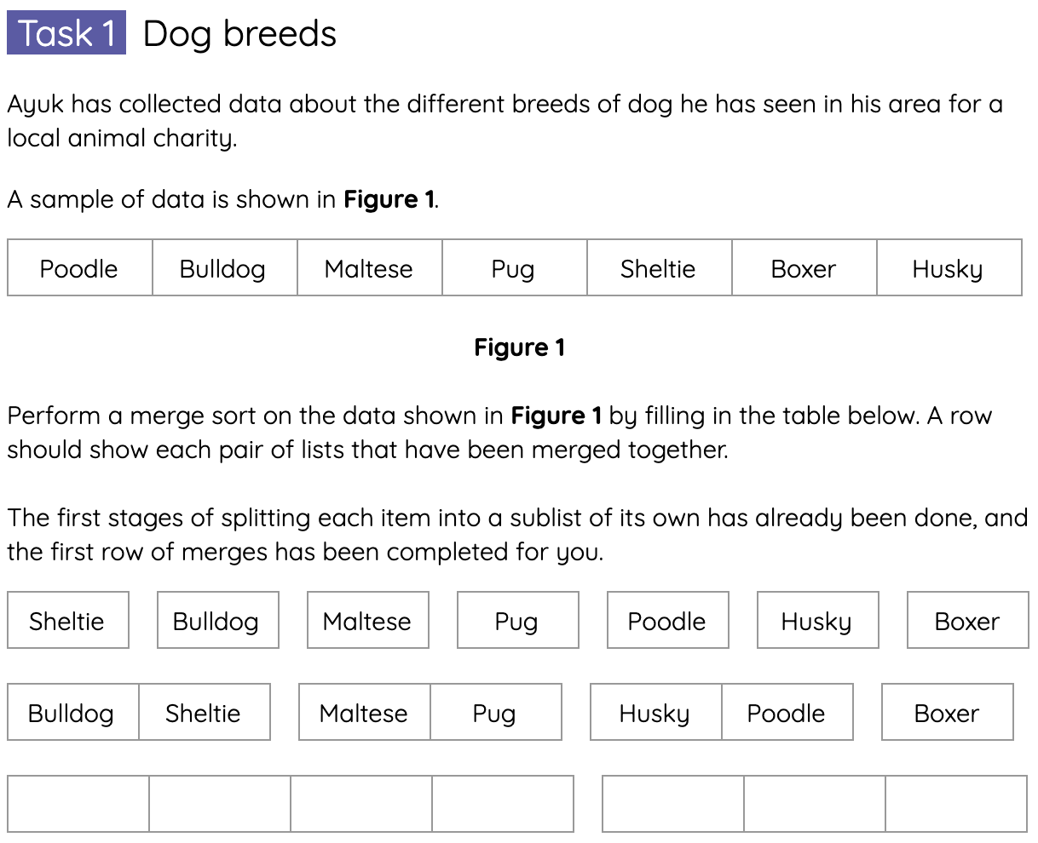
Executing a merge sort
Activity 3
Complete the tasks on the Activity 3 worksheet for executing a merge sort.

Slide 45
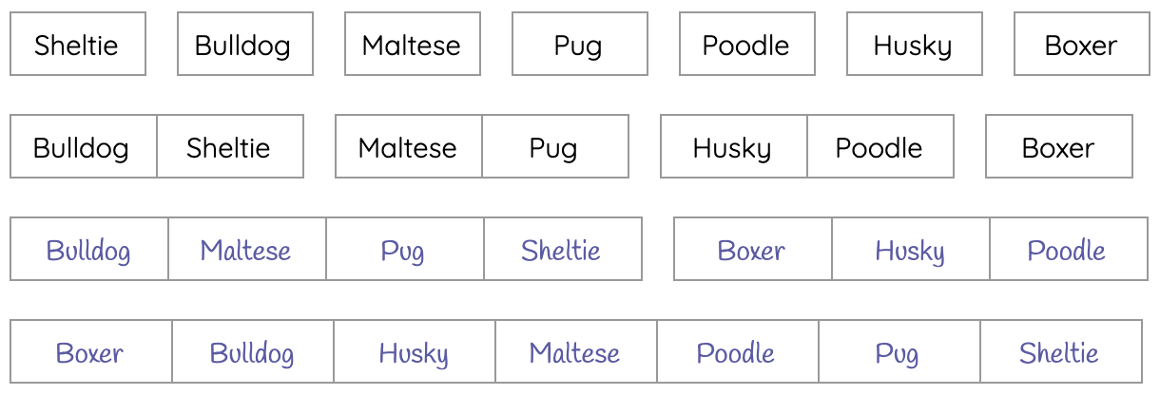
Executing a merge sort
Activity 3
Below is the solution for each row of merges in the first task:

Slide 46
Divide and conquer
Activity 4
In computer science, merge sort is an efficient algorithm that implements a “divide and conquer” approach.
A “divide and conquer” algorithm works by breaking down a problem into smaller and smaller parts until these become simple enough to solve directly.

Slide 47
Efficiency of merge sort
Activity 4
When comparing sorting algorithms, merge sort will generally perform much faster than a bubble sort on a list of data especially on large data sets.
The downside to merge sort is that it requires more memory, often due to the new lists that need to be created.
The merge sort algorithm is also more complex to implement than bubble sort.

Slide 48

Summary of merge sort
Wrap Up
Merge sort works by splitting items in a list into individual lists before merging pairs of lists together in order until all the items are sorted.
Merge sort is an efficient “divide and conquer” algorithm that can perform well in real world use.
A merge sort algorithm is usually faster to execute but more complex to write than bubble sort.
Executing a merge sort takes up extra space in memory as new lists are made each time a list is split or two lists are combined.

Slide 49
Next lesson
Summary
In this lesson, you…
Merged two ordered lists of items into a new ordered list.
Described how merge sort is used for ordering a list of items.
Performed a merge sort to order a list containing sample data.
Next lesson, you will…
Review the topics you have covered in this unit.

